Slide 1

Notes:
Smith most popular name in
Proportion per 100k 880.85 in 2000 828.1 in 2010
US

Slide 2
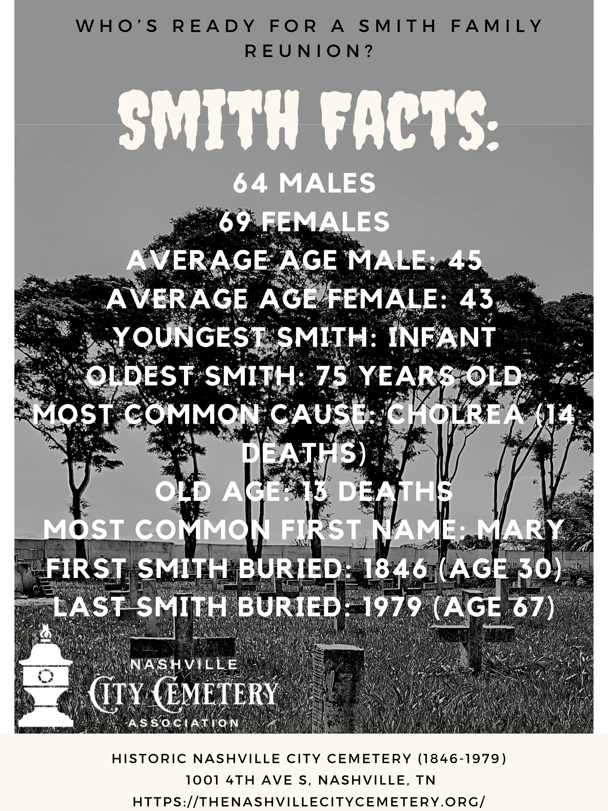
Notes:
There are 823.92 people named SMITH for every 100,000 Americans

Slide 3

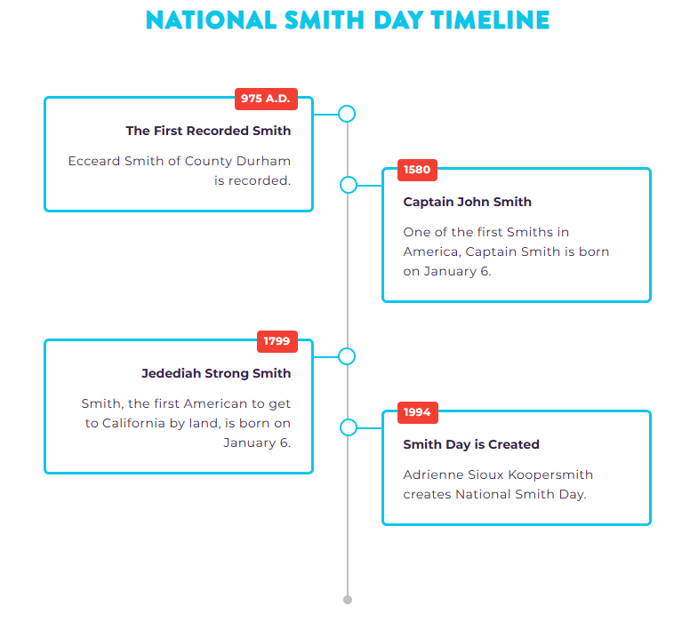

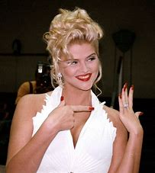
Notes:
$10 tix

